Slide 1

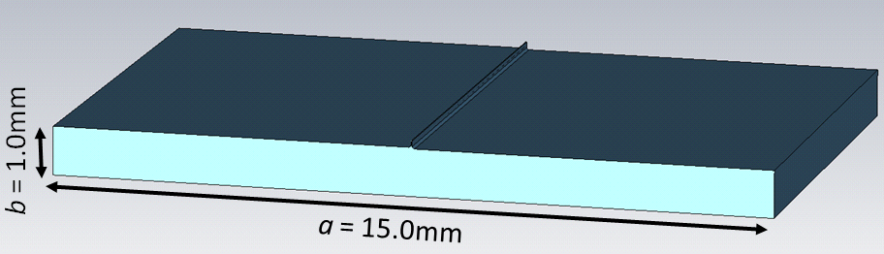
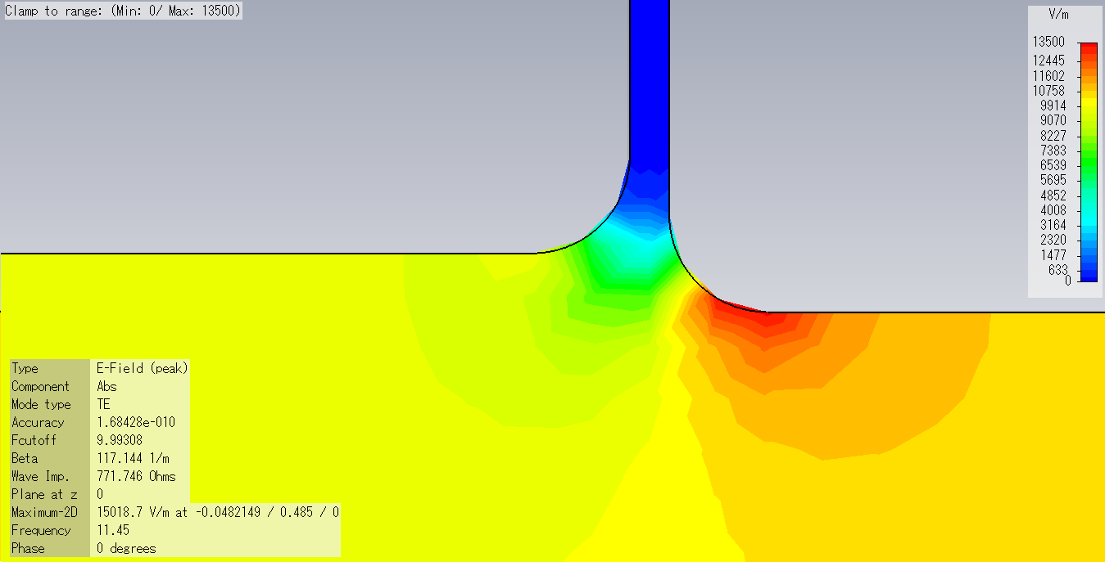
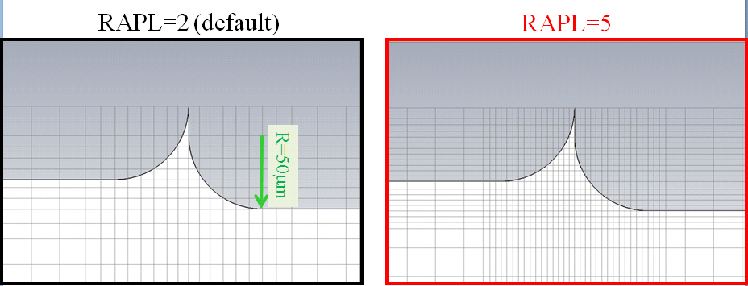
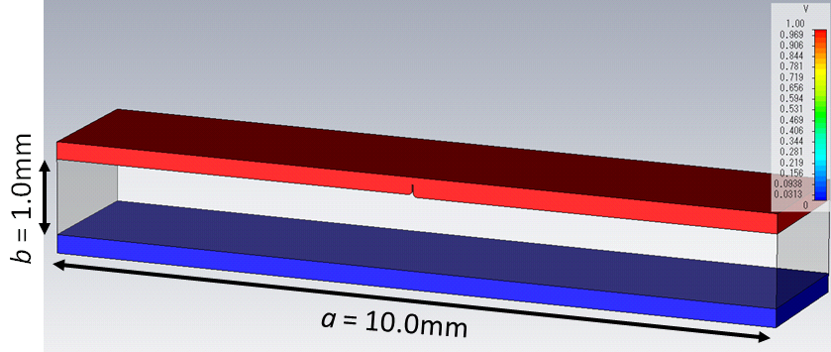
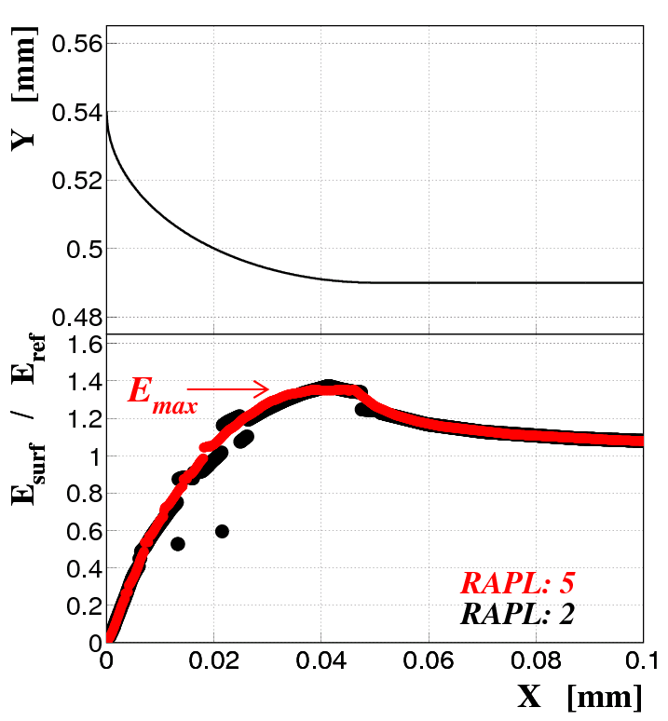
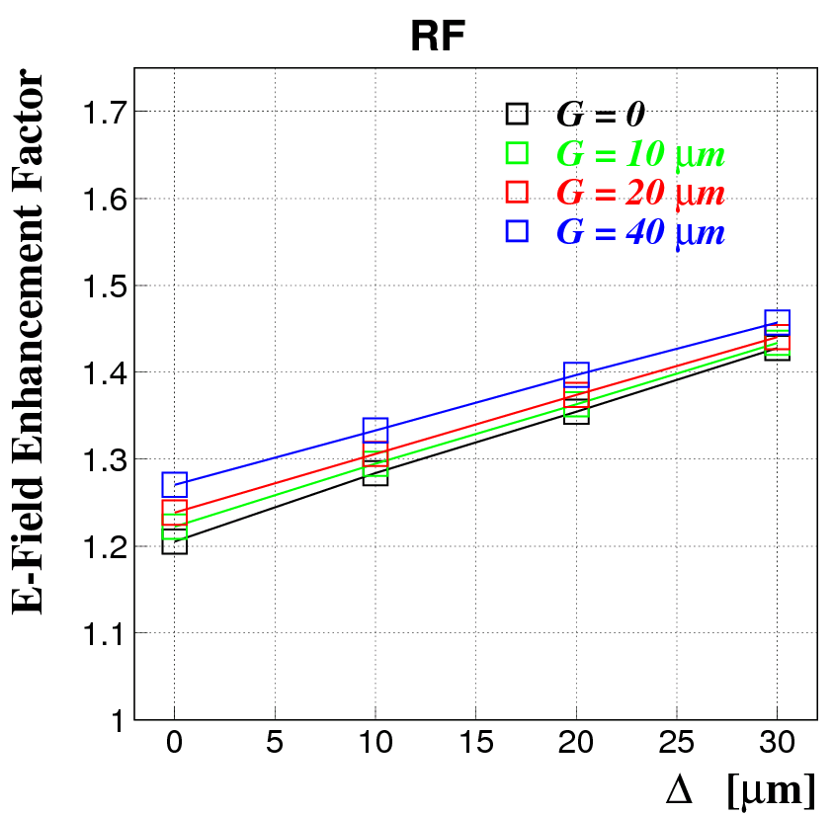
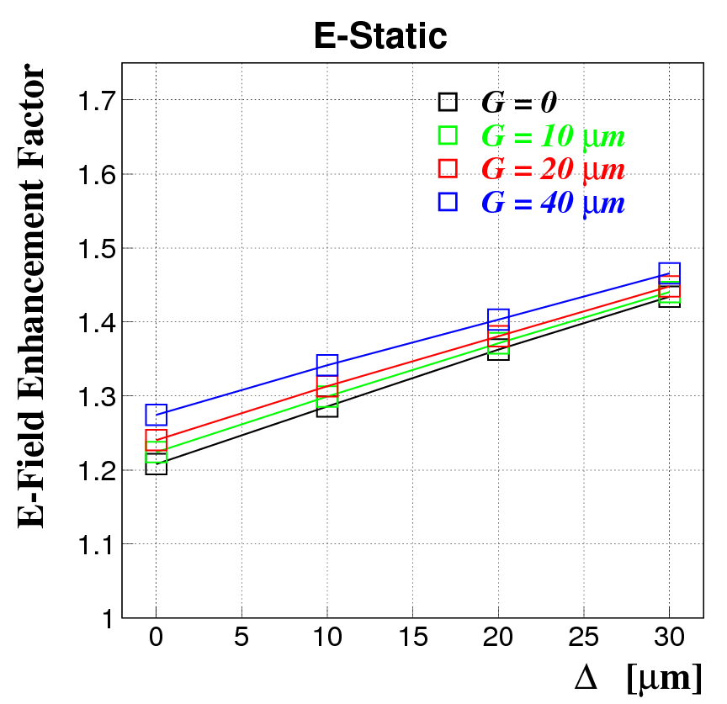
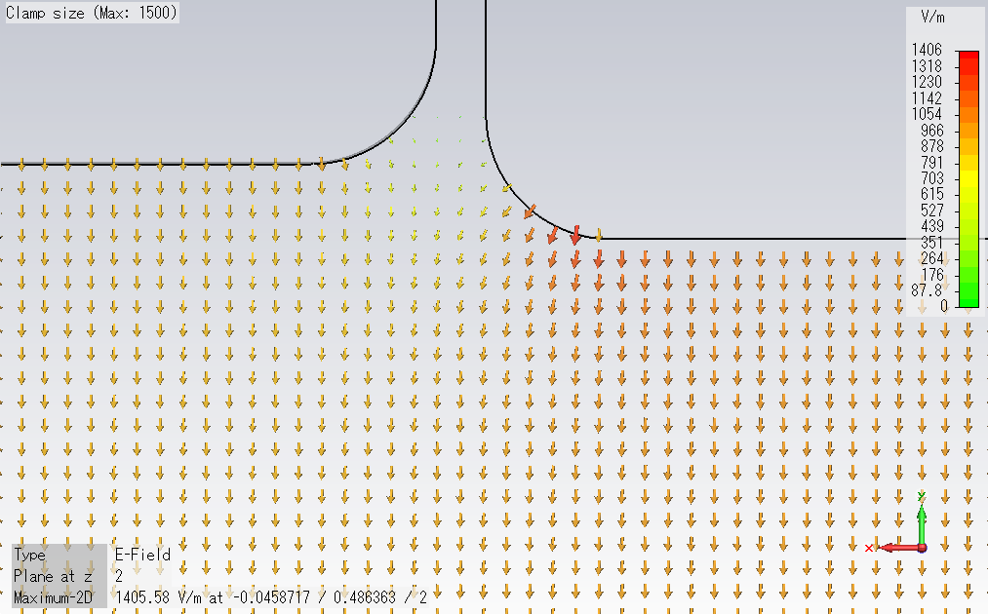
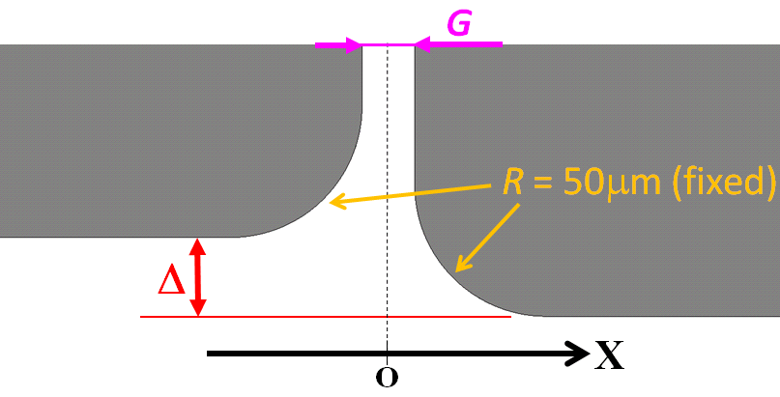
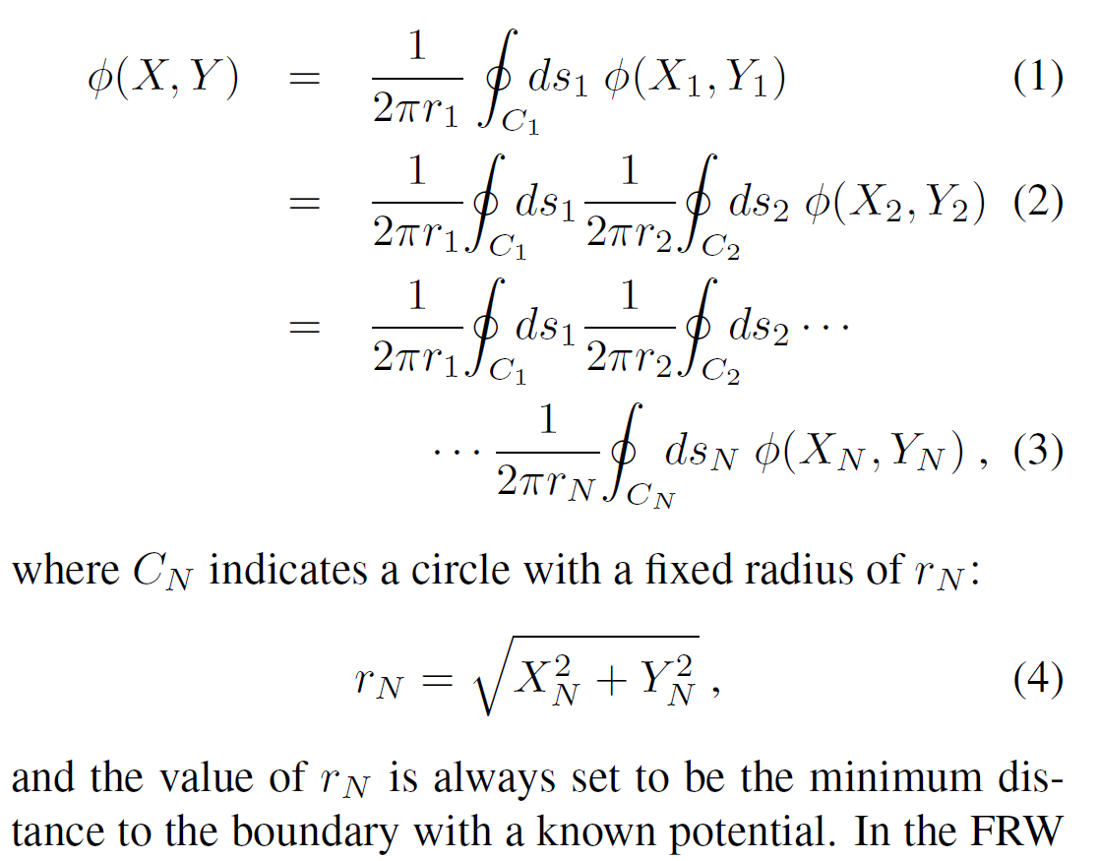
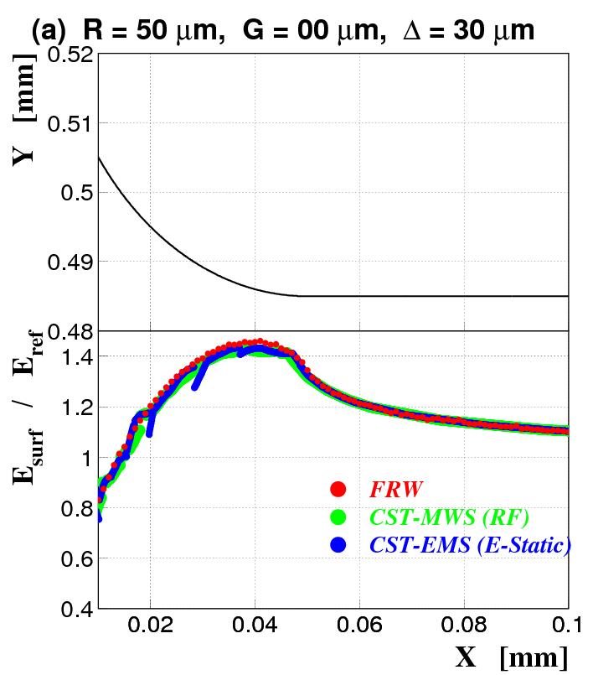
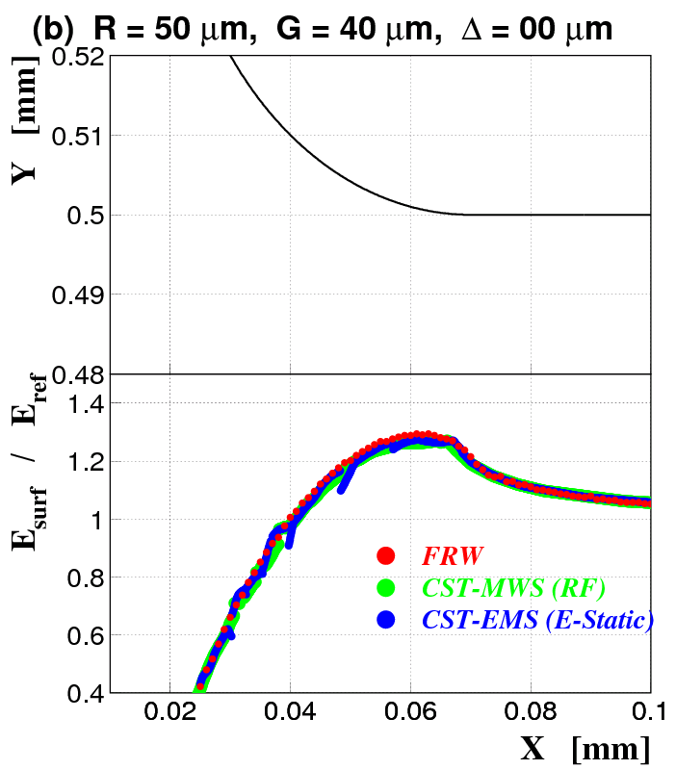
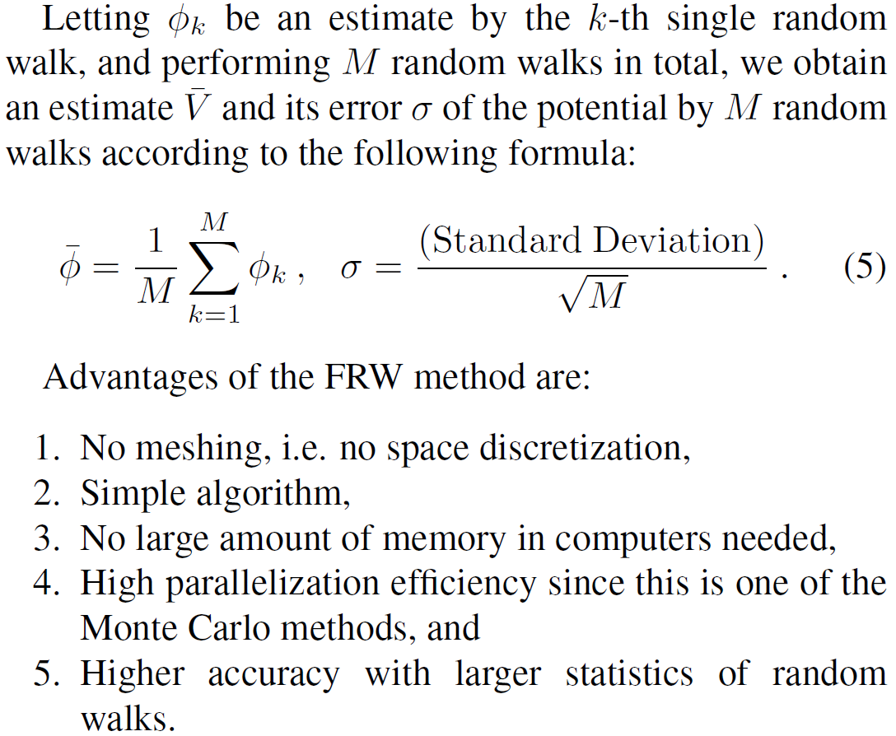
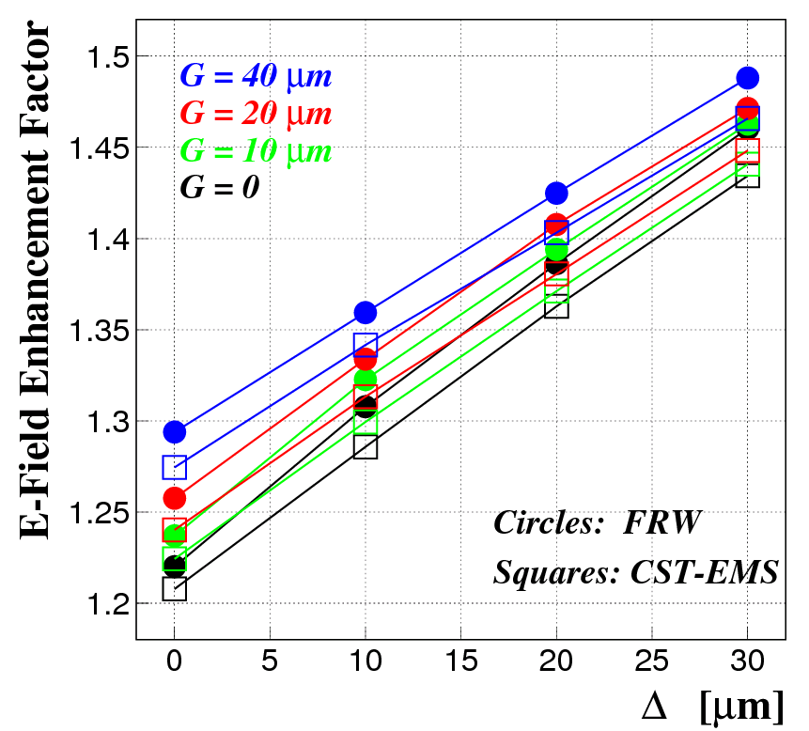
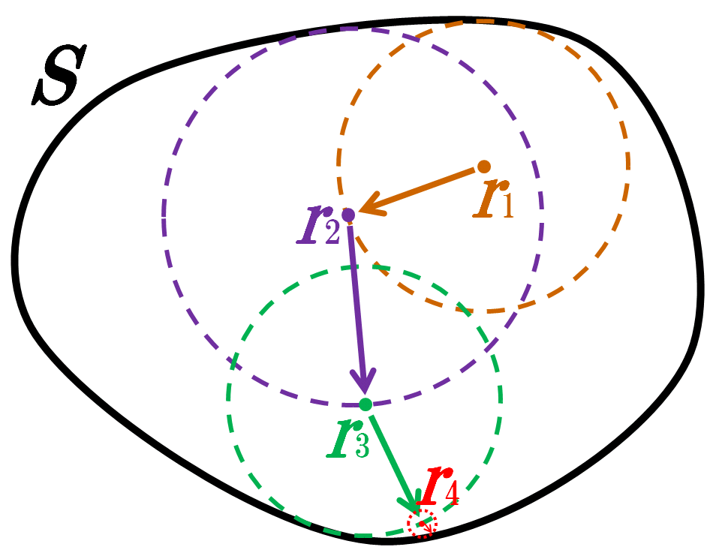
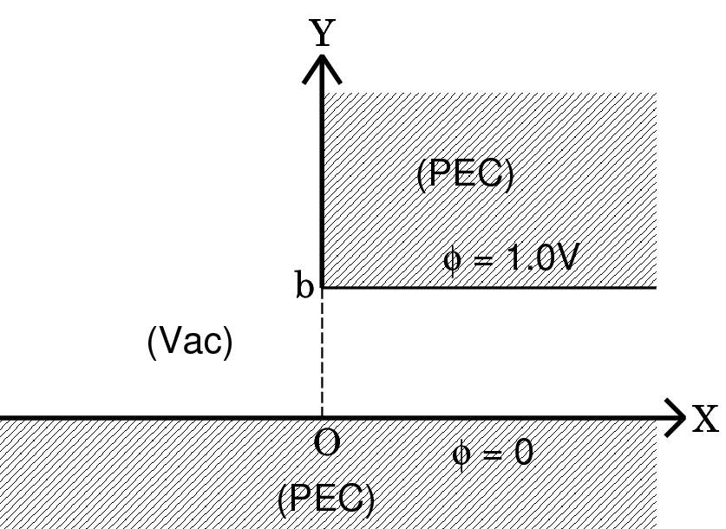
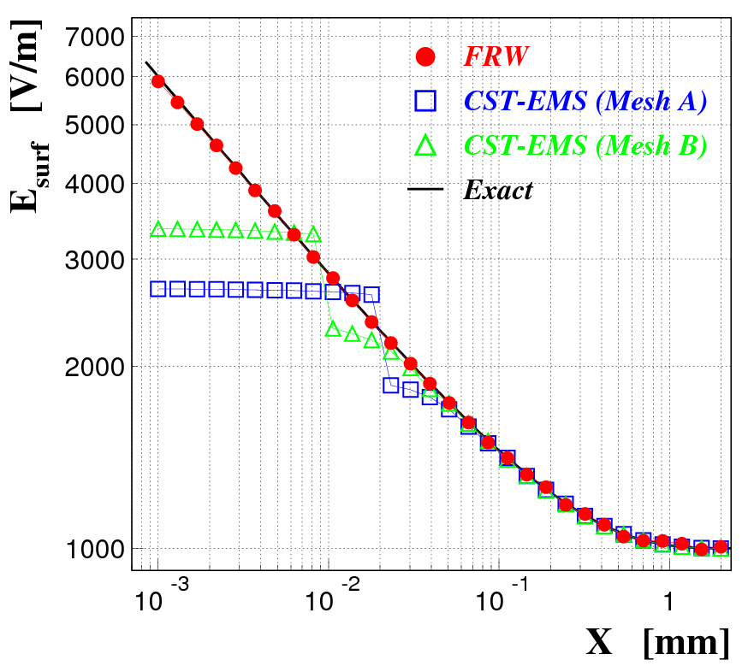
Study of Surface Field Enhancements due to Fine Structures
TUPS086
Tetsuo ABE
High Energy Accelerator Research Organization (KEK), Tsukuba, Ibaraki 305-0801, Japan
Using CST-MWS (RF)
Using CST-EMS (E-Static)
Rectangular Waveguide with fcutoff(TE10) = 10 GHz
A small groove at the center of the E-plane
Port mode computation of TE10
Hexahedral meshing with PBA
Computation based on the FIT
Two parallel PEC plates with a small groove
Potential difference: 1.0V
Hexahedral meshing with PBA
Computation based on the FIT
(adopted)
~
~
=
~
1000[V/m]
(PEC)
Floating Random Walk (FRW)
(Vac)
(PEC)
Introduction
High-gradient radio-frequency (RF) accelerating structures are linchpins of high-energy accelerators to search for new physics in particle physics. However, fine surface defects in the structures, such as burrs from machining and undulations due to crystal structures, could increase surface fields and/or surface heating, and trigger breakdown of the accelerating structures, leading to deterioration of accelerator performance.
As is well known, projection tips, or similar fine structures, can dramatically increase local surface fields. On the other hand, how much is field enhancement at fine concave structures? Such structures could be made at bonding planes, e.g. of quadrant-type X-band accelerating structures for CLIC. This is a problem presented in this paper, and surface-field enhancement factors are numerically calculated with three different methods: RF- and electrostatic-field simulations based on the Finite Integration Technique (FIT) and floating random walk (FRW).
This algorithm is implemented in a computer program for GPGPU
written in Fortran 2003 / CUDA Fortran.
Conclusions
Field enhancements due to small grooves with round chamfers
have been computed by using CST-MWS/EMS and FRW.
- At least 20% enhancement for R=50μm round chamfers.
- Increases to 40% enhancement
as the Δ size increases to 25μm.
- Agreements among the three methods.
It has been demonstrated in this study that the FRW method gives high-precision calculations of local fields, and it is practical and promising because of its suitability for GPGPU computing.
This FRW method is applicable to any structure.
Benchmark Test
1.0mm
Schematic Diagram of FRW

